Slide 1
Unit 3 Lecture 8

Slide 2
Open Systems Interconnection (OSI) Model:
An Open System is a set of protocols that allows any two different systems to communicate regardless of their underlying architecture.
The purpose of the OSI Model is to show how to facilitate communication between different systems without requiring changes to the logic of the underlying hardware and software.
The OSI Model is a model for understanding and designing a network architecture that is flexible, robust, and interoperable.

Slide 3
The OSI model is a layered framework for the design of network systems that allows communication between all types of computer systems.
It consists of seven separate but related layers, each of which defines a part of the process of moving information across a network.

Slide 4
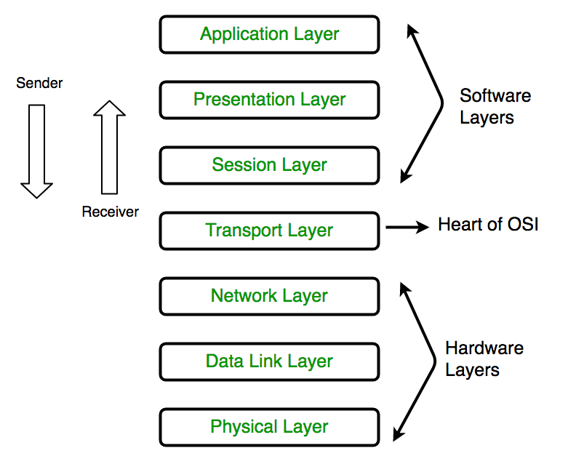

Slide 5
Why Layered Architecture
To divide the design into small pieces .
Each lower layer adds its services to the higher
layer to provide full set of services.
To manage and run the applications.
It provides modularity and clear interfaces i.e provides interaction between subsystem.

Slide 6
Functions of a Physical layer:
Line Configuration: It defines the way how two or more devices can be connected physically.
Data Transmission: It defines the transmission mode whether it is simplex, half-duplex or full-duplex mode between the two devices on the network.
Topology: It defines the way how network devices are arranged.
Signals: It determines the type of the signal used for transmitting the information.

Slide 7
2. Data Link Layer
Physical Addressing: The Data link layer adds a header to the frame that contains a destination address.
Flow Control: Flow control is the main functionality of the Data-link layer. It is the technique through which the constant data rate is maintained on both the sides so that no data get corrupted
Error Control: Error control is achieved by adding a calculated value CRC (Cyclic Redundancy Check) that is placed to the Data link layer's trailer which is added to the message frame before it is sent to the physical layer.
Access Control: When two or more devices are connected to the same communication channel, then the data link layer protocols are used to determine which device has control over the link at a given time.

Slide 8
3. Network Layer:
Internetworking: An internetworking is the main responsibility of the network layer. It provides a logical connection between different devices.
Addressing: A Network layer adds the source and destination address to the header of the frame.
Routing: Routing is the major component of the network layer, and it determines the best optimal path out of the multiple paths from source to the destination.
Packetizing: A Network Layer receives the packets from the upper layer and converts them into packets. This process is known as Packetizing.

Slide 9
3. Transport layer
The Transport layer is a Layer 4 ensures that messages are transmitted in the order in which they are sent and there is no duplication of data.
The main responsibility of the transport layer is to transfer the data completely.
It receives the data from the upper layer and converts them into smaller units known as segments.
This layer can be termed as an end-to-end layer as it provides a point-to-point connection between source and destination to deliver the data reliably

Slide 10
Functions:
Segmentation and reassembly
Connection control
Flow control
Error control

Slide 11
5. Session Layer
The Session layer is used to establish, maintain and synchronizes the interaction between communicating devices.
Functions:
Dialog control: Session layer acts as a dialog controller that creates a dialog between two processes or we can say that it allows the communication between two processes which can be either half-duplex or full-duplex.
Synchronization: Session layer adds some checkpoints when transmitting the data in a sequence. If some error occurs in the middle of the transmission of data, then the transmission will take place again from the checkpoint

Slide 12
6. Presentation Layer
A Presentation layer is mainly concerned with the syntax and semantics of the information exchanged between the two systems.
It acts as a data translator for a network.
This layer is a part of the operating system that converts the data from one presentation format to another format.
The Presentation layer is also known as the syntax layer.

Slide 13
Functions:
Translation:
Encryption:
Compression:

Slide 14
7. Application Layer
An application layer serves as a window for users and application processes to access network service.
It handles issues such as network transparency, resource allocation, etc.
An application layer is not an application, but it performs the application layer functions. This layer provides the network services to the end-users

Slide 15
Functions:
File transfer, access, and management (FTAM): An application layer allows a user to access the files in a remote computer, to retrieve the files from a computer and to manage the files in a remote computer.
Mail services: An application layer provides the facility for email forwarding and storage.
Directory services

